Slide 1
Uber Case Study
Case Study 2
Gajanan Desai

Slide 2
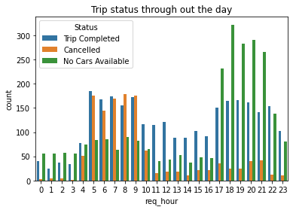


Fig. 1: Status of the requests
throughout the day
Considering both the locations
Observations:
- Overall unavailability of cars is higher from 5:00 PM to 11:00 PM.
Overall cancellation is higher during 5:00 AM to 10:00 AM.
- Hourly trip status characteristics remains independent of the date.

Slide 3
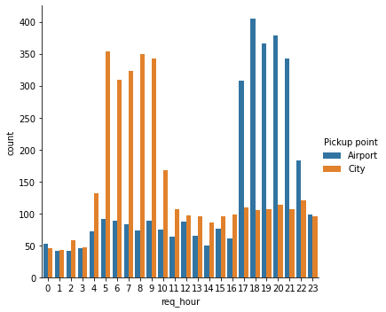
Fig.2 : Hourly number of requests made
at the City and the Airport
Observations:
- During morning hours (4:00 AM to 11:00 AM) most of the requests were made at the City.
- During evening hours (5:00 PM to 11:00 PM) most of the requests were made at the Airport.

Slide 4
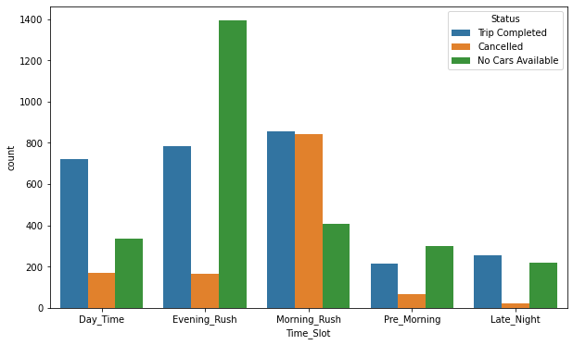
Fig.3 : Status of the requests
For different time slots.
Observations:
- Overall(combining all pickup points) unavailability of cars is highest during the
evening rush hour.
- Overall most cancellations occurs during the morning rush time-slot.

Slide 5
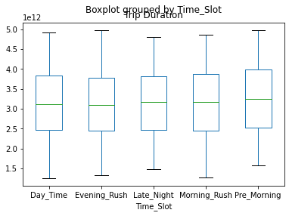
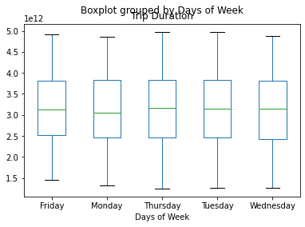
Observations:
- Boxplots for the duration of trips seems not much conclusive. The median trip time for the Pre-morning hours is very little higher than other time-slots.
- Trip durations are almost same for all the days of the week.

Slide 6
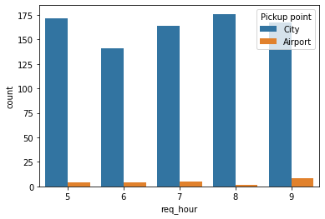
Fig.5 : Numbers of cancellations during morning rush time-slot.
Observations:
- During morning rush hours number of cancellations from the City is much higher than the number of cancellation from Airport.

Slide 7
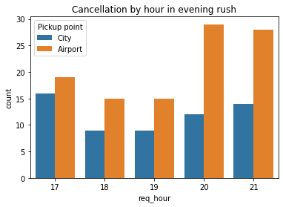
Fig.6 : Numbers of cancellations during evening rush time-slot.
Observations:
- During evening rush hours number of cancellations from the Airport is higher than
the number of cancellation from City.
- Most cancellations from the Airport happened during 8:00 PM and 9:00 PM.

Slide 8
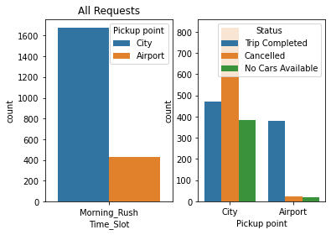
The figure on the left shows the all the requests made during morning rush hours from Airport and City. We can think that figure on the left as a visualization of total demands. The figure on the right shows how much of the demands are met.
Observations:
- During the morning rush time-slot number of requests made from the City is much higher than the requests made from the Airport.
Cancellations and unavailability of cars is also much higher in the City during the morning rush time slot.
More cars need to be alloted to the City during morning rush time-slot.

Slide 9
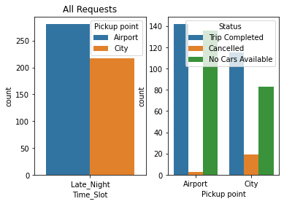
The figure on the left shows the all the requests made during late night hours from Airport and City. We can think that figure on the left as a visualization of total demands. The figure on the right shows how much of the demands are met.
Observations:
Higher numbers of unavailability of cars is noticable from the Airport during the late night time-slot.
Number of requests is higher from the Airport than the requests from the City during the late night time-slot.

Slide 10
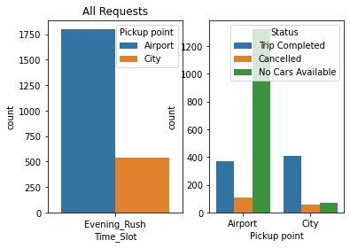
The figure on the left shows the all the requests made during evening rush hours from Airport and City. We can think that figure on the left as a visualization of total demands. The figure on the right shows how much of the demands are met.
Observations:
-Number of requests is much higher from the Airport than from the City during the evening rush time-slot.
- Unavailability of cars is very severe at the Airport during the evening rush time-slot. Most of the requests could not be met due to the unavailability of cars at the Airport during the evening rush.

Slide 11
Conclusions:
* Unavailability of Cars is most severe during evening rush hours. Irrespective of the pick-up points more cars need to be alloted during evening rush hours.
* More cars need to be alloted for Thursday and Friday.
* During morning rush time-slot more cars need to be alloted to the City.
* During evening rush time-slot more cars need to be alloted to the Airport.
* During late night time-slot more cars need to be alloted to the Airport.

